Slide 1

ELECTRICITY
CAPPING DEVICE
By: Akash Ramakrishnan
Anish Jagadale
Deepro Bose
Soham Mitra

Slide 2
Introduction :
With the development in technology the average usage of electricity is increasing exponentially due to usage of various heavy appliances. The main problem the middle class faces is paying the exorbitant amount of bills that this generates.
The only way we can solve this is by limiting our daily use of all major electronic appliances, to do this we must have a complete understanding of the unit system the electricity boards use to generate the bills. The basic definition of units are based on wattage.

Slide 3
Our Goal :
During the Covid pandemic a big crisis is the electricity bill issue, the company incharge had temporarily reduced the bill for a fixed amount of months but suddenly the deficit was reflected in the next month and no proper explanation was given.
To maintain transparency, we aim to develop a device which will remind us of our daily usage and warn us if we cross a dynamic threshold

Slide 4
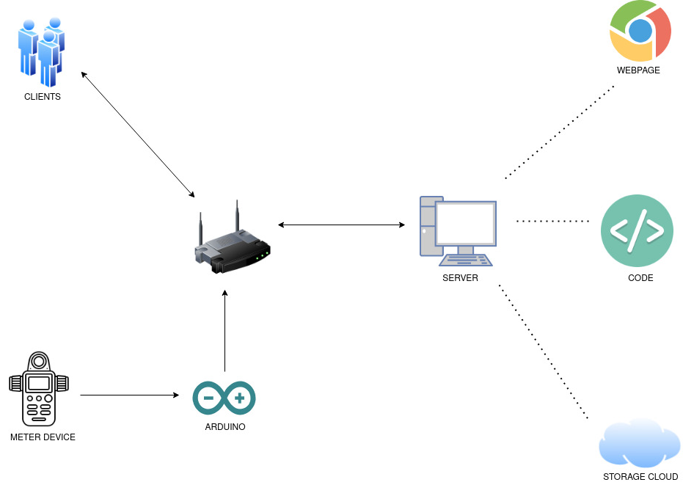

Slide 5
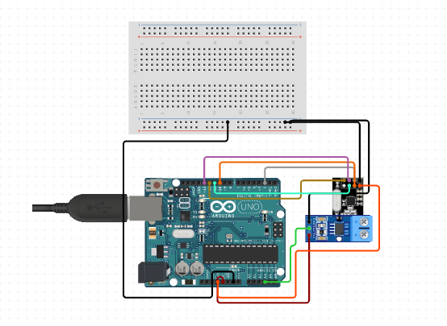
Arduino Circuit :
An Arduino circuit is used to process the data collected from the meter device
Circuit is connected to RPi which uploads the information to the internet.

Slide 6
Analysis:
The analysis part is done using two python files. The first python file (‘DailyData.py’) accesses the csv file(‘data.csv’) containing the hourly wattage readings from the sensor and calculates the total readings of that particular day. This file is executed on an hourly basis and simultaneously uploads data to the http server so that the user can have an hourly check on his or her usage on that particular day.
The second python(‘MonthlyData.py’) file also accesses the same raw csv file as the first one (‘data.csv’) and extracts the data of that particular day. This data is then processed and added to two datasets (‘discrete.csv’) and (‘cont.csv’) containing discrete and continuous daily data of the month. This python file is executed on a daily basis.
Both files are automatically run on an hourly and monthly basis using the crontab feature. Crontab is a feature that runs on linux based operating systems. It helps in scheduling file execution based on the timing set.

Slide 7
Website:
Website is an important aspect as we needed a user interface where users can get to know about his/her consumption. username:anish , pass:1234).
The user would be able to access his/her graph and other information.
For making this website we used :
Php
Html
CSS
Bootstrap
Javascript
Json
MYSQL
For graphs we used the Google Charts

Slide 8
Key Points …..
This is an endeavour to device an Instrument which will be Cheaper, User Friendly and can be effectively used by a consumer of electricity in Vilages, rural and metropolitan areas.
Such data will help the Consumer to visualise his Electricity Consumption cost, before hand. Thereby the Consumer may controll on his experiences.
It will be possible to display every day's consumption & Cumulative expenses incurred.
LAST & NOT THE LEAST this can bring awareness & trust between the Service provider and the Consumer.

